Slide 1
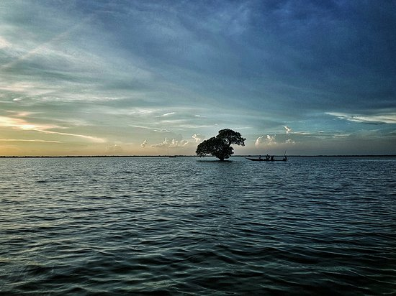
The Hakaluki Haor
Name : Syeda Nowshin Ibnat
ID No : 017183103020
Dept. : CSE
Course title : English language 1
Course code : ENG 101

Slide 2
The Hakaluki Haor Hakaluki: A rich hub of biodiversity and livelihood
Introduction: Bangladesh is blessed with huge inland open water resources hakaluki haor is one of the major wetlands of Bangladesh.
This haor is a marsh wetland ecological system of North-Eastern Bangladesh and it is one of Bangladesh’s largest and one of Asia’s larger
Marsh wetland resources. It supports a rich biodiversity and provides direct and indirect livelihood benefits to nearly 200000 people.
The surface area of hakaluki haor is 181.15 hectors(km^2) of which 72.46 hectors is within the territory of Barlekha Upozila.It is also under Kulaura Juri Upazila of Moulvibzar District and Golapganj,Fenchuganj
Upazila of Sylhet district.Hakaluki haor is situated in the estern part of Bangladesh border.5 upazillas comprise this haor’s total area.

Slide 3
It is a complex ecosystem , containing more than 238 interconnecting beel and jalmahals.The most important beels are Chatla,pinlarkona,dulla,sakua,balijhuri,lamba,haorkhal,tural and baghalkuri .The beels of hakaluki haor provide winter shelter for the mother of fisheries.
Hakaluki haor is an important source of fisheries resources for Bangladesh .Pabda,rui,kalibaus,chapila are the main fish species found here .Fishes of 107 species were available in the haor but a report of IUCN in 2008 represented that only 75 species remains today.

Slide 4
The Haor basin supports numerous wetland habitats.It provides sanctuary to many species of animals and birds including some rare kinds.A total of of 558 of animals and birds have been identified here.
Turtle ,otters,dolphin,snakes are some of the species.

Slide 5
The haor is a important resting place for migratory waterfowls.In every winter a large of migratory birds of about 150 species from Siberia and other cold regions flock to the haors.Most interesting species is the Barheaded Goose.It is also known as a good grazing land in winter.
During the dry season,approximately 44000 haor are is covered by the beel ,but with the onset of rains in summer the entire area floods to about four and half times of this size and remains under water for up five months.During this period, all the beels are united as one large lake or haor ,making hakaluki haor the largest freshwater wetland in Bangladesh.And it looks like a infinite water kingdom.

Slide 6
Though the hakaluki haor is an assembles of biodiversity and very dense swamp forests in the past .But for deforestation and a lack of conservation practices have virtually destroyed this unique forest in the last decades.For this reason the Department of Envirinment decleared as ecologically critical area in 1999 and mentioned some problems.such as-
Indiscriminate use of resourses
Conversion of wetlands into rice filds.
Drying up haor beels for fishing are some of them

Slide 7
In order to conserve and protect the biodiversity of hakaluki haor from destroying , government organizations have funded some different programs.
At the last it can be said that if proper and effective management steps should be taken and followed by government and NGO’s then it will be the exhaustive source for both biodiversity and beauty not only for Bangladesh but also for the whole world.
THANK YOU !

